Slide 1

Adopting Automation in Agile Testing
Project id: E9953
Feb 2014
Confidential | Copyright © Larsen & Toubro InfoTech Ltd.

Slide 2





Agenda
1
4
Overview
The Mitigations
3
The Challenges
2
2
5
What is Automation in Agile
Some Metrics
Confidential | Copyright © Larsen & Toubro InfoTech Ltd.

Slide 3


What is Automation in Agile
Confidential | Copyright © Larsen & Toubro Infotech Ltd.

Slide 4


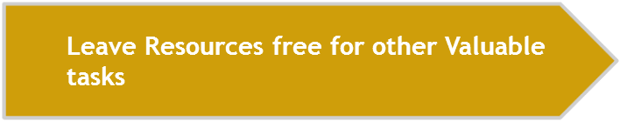
What is Automation in Agile
Tested Early and Often
Automation reduces testing time
Impossible to Automate Everything-Frees time for manual testing
Confidential | Copyright © Larsen & Toubro Infotech Ltd.

Slide 5

The Challenges
Confidential | Copyright © Larsen & Toubro InfoTech Ltd.

Slide 6

Knowledge Sharing
Relevant and up-to-date information about things that work for an agile team in particular iteration:
Individuals’ responsibility
Various development and testing tasks in progress
Comparison between actual and expected result
Confidential | Copyright © Larsen & Toubro Infotech Ltd.

Slide 7

Reusability
Test case reusability across different environment
Test script, which provides appropriate coverage from low level to production environment
Confidential | Copyright © Larsen & Toubro Infotech Ltd.

Slide 8

Tools And Frameworks
Define tools, which will provide appropriate quality of end product
Necessary training required for amateur resources
Confidential | Copyright © Larsen & Toubro Infotech Ltd.

Slide 9

Time Constraint
Iteration duration (two weeks)
Relaying information across locations
Confidential | Copyright © Larsen & Toubro Infotech Ltd.

Slide 10

Test Data Management
Multiple testing phases
Need arises for test data refresh after every iteration
Confidential | Copyright © Larsen & Toubro Infotech Ltd.

Slide 11

Return Of Investment
Factors majorly affecting ROI:
Selection of framework
Type of planning
Confidential | Copyright © Larsen & Toubro Infotech Ltd.

Slide 12
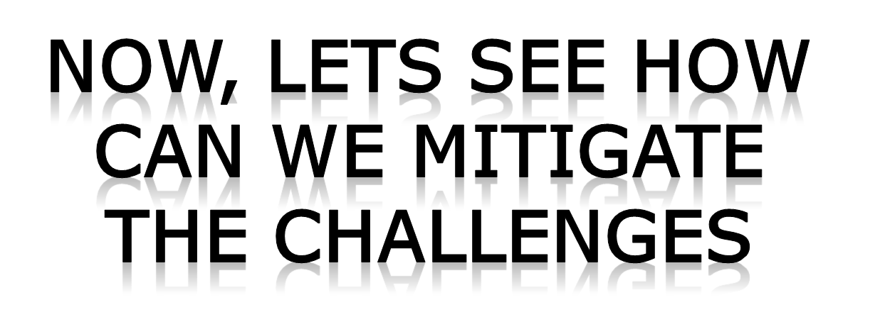
Ways To Streamline
Confidential | Copyright © Larsen & Toubro InfoTech Ltd.

Slide 13


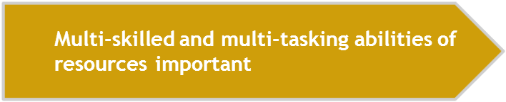

Ensure Team Cohesion
Confidential | Copyright © Larsen & Toubro Infotech Ltd.

Slide 14

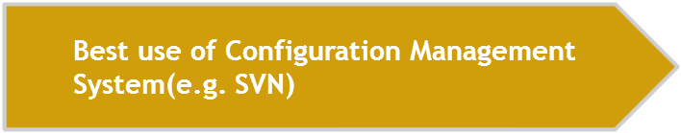
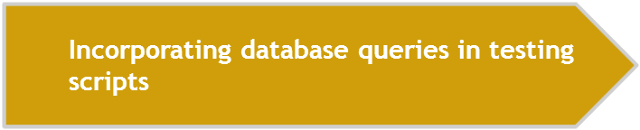
Maintaining Test Data
Confidential | Copyright © Larsen & Toubro Infotech Ltd.

Slide 15
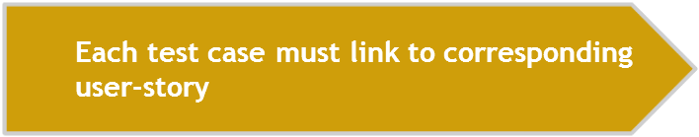
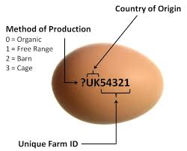

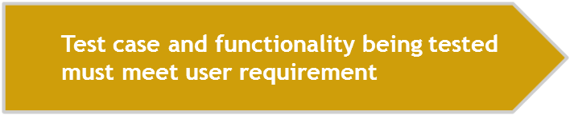
Ensure Traceability
Multi-skilled and multi-tasking abilities of resources important
Confidential | Copyright © Larsen & Toubro Infotech Ltd.

Slide 16

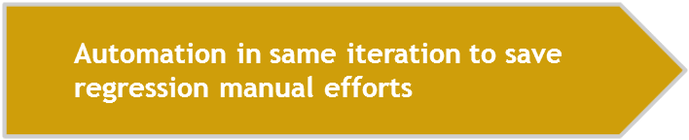

Use Pair-Testing
Confidential | Copyright © Larsen & Toubro Infotech Ltd.

Slide 17
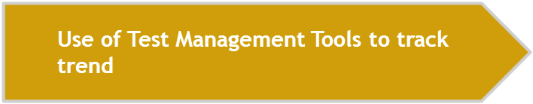


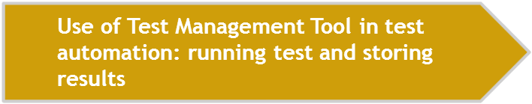
Use Layered Tools
We use HP-QTP v 11.0 merged with HP Quality Centre
Confidential | Copyright © Larsen & Toubro Infotech Ltd.

Slide 18






About Configuration Management tool
Confidential | Copyright © Larsen & Toubro Infotech Ltd.

Slide 19


Thank you
Our Business Knowledge,
Your Winning Edge.
Confidential | Copyright © Larsen & Toubro InfoTech Ltd.

